Slide 1

Django Models
Models, Migration, ORM
Program: EDGE-CSE CUET DIGITAL SKILLS TRAINING
Course: Python (Django) [Intermediate]
Lecture: Training Session-07 Date: 7th October, 2024 Duration: (2+2) hours
Instructor: Tanveer Rahman, Sr. Software Engineer, Friends Corp. Chuo-ku, Tokyo, JP shakil10vr@hotmail.com, 01626735005

Slide 2
Agenda
Django Models, Model Fields, Queries
Understanding Migrations
Advanced ORM Queries
Hands-on Tasks: Creating Relationship in Models, Custom Queries

Slide 3
Django Models
A model in Django is a class that defines the structure of database tables.
Importance of Models:
Simplifies database management.
Enables automatic generation of queries using Django's ORM.
Reflects real-world data and relationships.
Models serve as a blueprint for database tables and define the fields and behaviors of the data being stored.

Slide 4
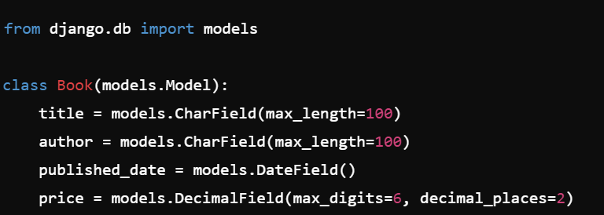
Creating Models in Django
Defining a Model
Models are Python classes that inherit from django.db.models.Model.
Fields are defined as class attributes.
Example: Basic Model

Slide 5
Model Fields in Django
Common Field Types
CharField: For short text (e.g., titles, names). IntegerField: For numbers. DateField: For date values. BooleanField: For True/False values. ForeignKey: To define relationships between models.
Example:
class Author(models.Model): name = models.CharField(max_length=100)

Slide 6
Django ORM
What is Django ORM?
The Django ORM (Object-Relational Mapping) allows you to interact with the database using Python code instead of SQL. Querysets are used to retrieve, filter, and manipulate data from the database. Supports all CRUD (Create, Read, Update, Delete) operations.

Slide 7
Django ORM Queries
Basic ORM Queries
Retrieve all records:
books = Book.objects.all()
Filter records:
books = Book.objects.filter(author="John Doe")
Get a single record:
book = Book.objects.get(id=1)

Slide 8
Understanding Migrations
What Are Migrations?
Migrations are Django's way of propagating changes you make to models (adding a field, deleting a model, etc.) into your database schema. Migrations help manage the schema and keep it synchronized with your models.
Commands for Migrations:
Create migrations:
python manage.py makemigrations
Apply migrations:
python manage.py migrate

Slide 9
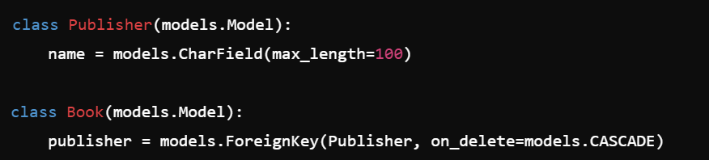
Creating Relationships in Models
Types of Relationships:
OneToOneField: One-to-one relationship between two models. ForeignKey: Many-to-one relationship. ManyToManyField: Many-to-many relationship.
Example:

Slide 10
Task 1 - Create Basic Models (Duration: 30 mins)
Create two models: Author and Book.
Add fields to the Author model: name, birthdate.
Add fields to the Book model: title, publication_date, and a ForeignKey to Author.
Run the migration to create the corresponding database tables.

Slide 11
Advanced ORM Queries
Aggregations
Calculate average, sum, count, etc.:
Ordering and Slicing
Ordering:
Limit the number of results:
books = Book.objects.all()[:5]
from django.db.models import Avg, Count avg_price = Book.objects.aggregate(Avg('price'))
books = Book.objects.order_by('title')

Slide 12
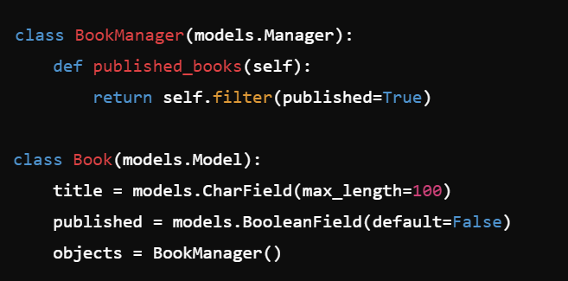
Model Managers and Custom Queries
Model Managers
The default manager in Django is objects. You can create custom managers to add additional query functionality.
Example:

Slide 13
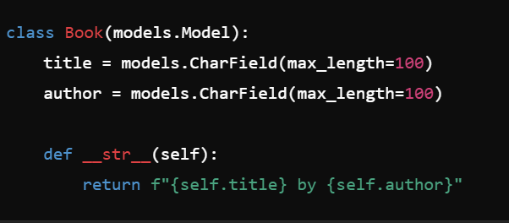
Model Methods
Adding Custom Methods to Models
You can define custom methods in a model to encapsulate certain behaviors.
Example:

Slide 14
Task 2 - Querying Data Using ORM (Duration: 30 mins)
Retrieve all books by a specific author.
Filter the books that were published in the last 5 years.
Sort books by price in descending order.
Calculate the average price of all books.

Slide 15
Understanding Django Querysets
What is a Queryset?
A queryset is a collection of database queries to retrieve objects from the database.
Lazy Evaluation
Querysets are not evaluated until they are specifically iterated over, making them highly efficient.
Chaining Queries
Queries can be combined and optimized: books = Book.objects.filter(author="John Doe").order_by('-published_date')

Slide 16
Task 3 - Model Relationships (Duration: 40 mins)
Add a Publisher model and link it to the Book model using a ForeignKey.
Write queries to list all books from a specific publisher.
Write a query to count how many books a particular publisher has published.

Slide 17
Best Practices
Use meaningful model names.
Leverage Django's built-in validation features (like max_length).
Avoid putting too much logic in the models; keep it focused on data.
Optimize your queries using select-related and prefetch-related.

Slide 18
Task 4 - Complete Model Application (Duration: 1 hour)
Create models for Author, Book, and Publisher.
Define appropriate fields and relationships.
Write Django ORM queries to:
Get all books by a specific author.
Find the publisher with the highest number of books.
Calculate the total number of books published in the last year.
Run migration, perform CRUD operations using Django ORM.

Slide 19
Recap
Models: Define database structure using Python classes.
Migrations: Automatically handle schema changes (makemigrations, migrate).
ORM: Interact with the database using Python, avoiding SQL.
Key queries: all(), filter(), get().
Relationships: ForeignKey, ManyToManyField, OneToOneField.
Practical Task:
Created models (e.g., Author, Book).
Performed CRUD operations and queried data.

Slide 20

Q&A Session

